Slide 1

Applied Data Science Capstone
Marcelo Rodrigues de Oliveira | IBM Data Science Professional Certificate

Slide 2
Where is the best place in NYC to run my new business ?
The main objective of this project is to create a solution that get location data from New York City and ﬁnd some recommendation of where are the best places to run a new business, according to density of business, visitation in the area and users rating for these categories in the neighborhoods.
Notes:
Esta é a pergunta à qual sua experiência deve responder

Slide 3
Business problem
Questions to be answered to define the our scope:
Which neighborhoods receive more visitors/customers ?
Which neighborhoods have the lower density of business like of yours ?
Which neighborhoods have worst average rates from customers for this
business category ?

Slide 4
Relevance and audience
Relevance:
It can be a template for those who are looking for models that find samples of data by comparing a group of features together
Audience:
Students
Entrepeneurs
Business analysts
Others

Slide 5
Methodology
1. Users must choose a business category based on Google Places API venues types. We use cafe.
2. We will build a dataset to be the input of machine learning model with the following columns:
NEIGHBORHOOD
VENUE_COUNT
USER_COUNT
CATEGORY_AVG
Notes:
Resuma a pesquisa entre três e cinco tópicos.

Slide 6
Data
Sources:
New York City Neighborhod Names from:
https://geo.nyu.edu/catalog/nyu 2451 34572
Venues information from:
Foursquare API / Google Places API
Data needs to be cleaned and transformed:
Normalization
Aggregation
Notes:
Resuma a pesquisa entre três e cinco tópicos.

Slide 7
Machine Learning algorithm selected
K-Nearest Neighborhood with:
K = 1
algorithm = “brute”
metric = “euclidean”
Notes:
Resuma a pesquisa entre três e cinco tópicos.

Slide 8
Prediction
Target point:
VENUE COUNT , near to 0 as possible.
USER_COUNT , near to 1 as possible
CATEGORY_AVG , near to 0 as possible
Notes:
Resuma a pesquisa entre três e cinco tópicos.

Slide 9
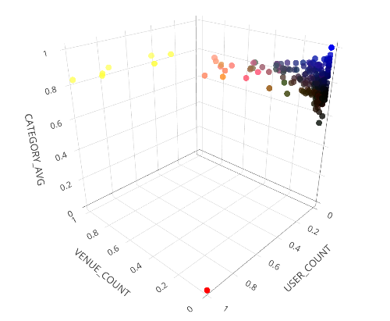
3D scatter plot of independent variables
The target point is in red

Slide 10
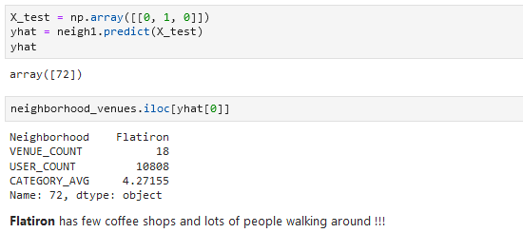
Code on Jupyter notebook for the case #1
Flatiron is the data point nearest to target point

Slide 11
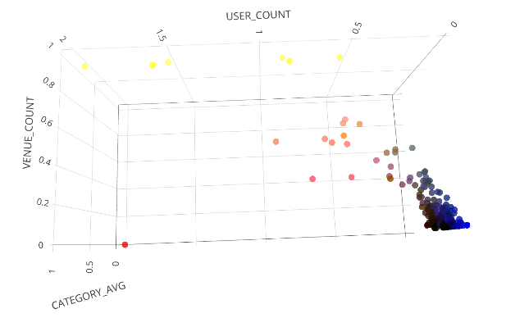
3D scatter plot for case #2
The target point is in red

Slide 12
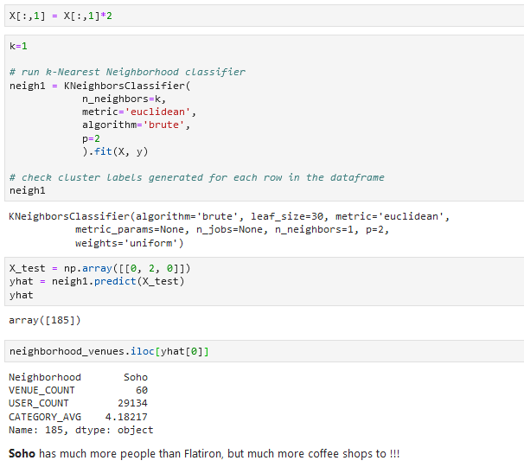
Code on Jupyter notebook for the case #2
Now, Soho is the data point nearest to target point

Slide 13
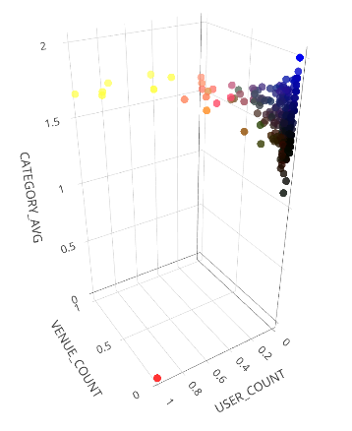
3D scatter plot for case #3
The target point is in red

Slide 14
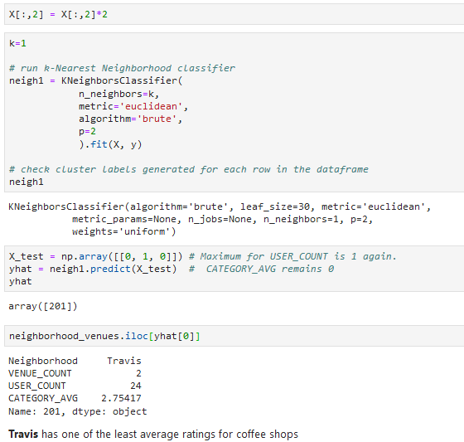
Code on Jupyter notebook for the case #3
Now, Travis is the data point nearest to target point

Slide 15
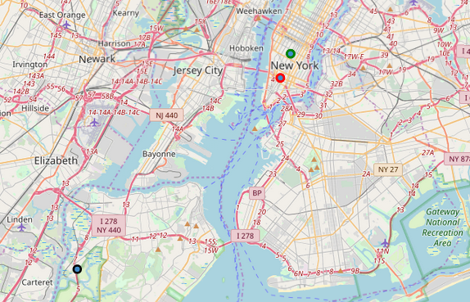
Map of New York City with predicted points
Travis in black, Soho in red and Flatiron in green

Slide 16
Discussion
“If you want low competition go to Travis, but how many people there wants a cup of coffee ? If you go to Flatiron or Soho, be prepared to work hard because a lot of people need a good coffee. In Soho, you should be prepared for a "Coffee War", because there are lots of good coffee shops (average ratings in neighborhood is 4.18 out of 5.”

Slide 17
Conclusion
This work had some assumptions and a limited scope. So, it can be expanded in many directions. It would be good to try another machine learning algorithms. I think that get more data and create new models with additional variables are always welcome. For those that have good knowledge in scientific methods and statistics could help a lot finding flaws and proposing enhancements.

